Slide 1
Reinforcement Learning of a Four-Way Traffic Signal System
Joe Mockler
ENAE788Z: Decision-Making under Uncertainty
15 MAY 24

Slide 2
Motivation and Overview
Motivation:
Interconnected traffic systems all require some form of control
Most widely adopted controller: the traffic light (~300,000 in the US)!
But how do we decide (1) what lanes to go and (2) for how much time?
Overview:
Define an MDP model of a signalized intersection
Use traditional analysis method to design a controller
Use a RL algorithm to solve the MDP and design a controller!
Notes:
Don’t belabor the point, traffic lights are everywhere, but the main design question is how should we use them to decide what lanes to go and for how much time?
Overview – read through

Slide 3
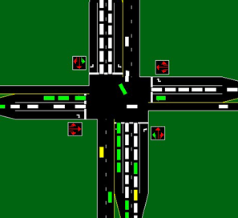
Background: Traffic Flow Theory
Terminology [7]:
Phase: part of a cycle allocated to one or more streams of traffic
Cycle: One complete sequence of the light such that every lane group gets a green
Saturation flow: flow-rate [veh/time] that a lane group can carry when the signal turns green. Note S = capacity / green time
Approach flow: incoming flow-rate for a lane group
Reproduced from [1]
Notes:
We’re going to go over some basic terms to get a background
READ LANE GROUP – then switch

Slide 4
Background: Traffic Flow Theory
Terminology [7]:
Phase: part of a cycle allocated to one or more streams of traffic
Cycle: One complete sequence of the light such that every lane group gets a green
Saturation flow: flow-rate [veh/time] that a lane group can carry when the signal turns green. Note S = capacity / green time
Approach flow: incoming flow-rate for a lane group
N: Left and S: Left get green
Reproduced from [1]
Notes:
Phase: read out. It’s essentially who gets a green for what part of the cycle
Cycle: One complete sequence of the light such that every lane group gets a green
Sat flow: flow of cars immediately when the light turns green
Approach flow: incoming flow

Slide 5
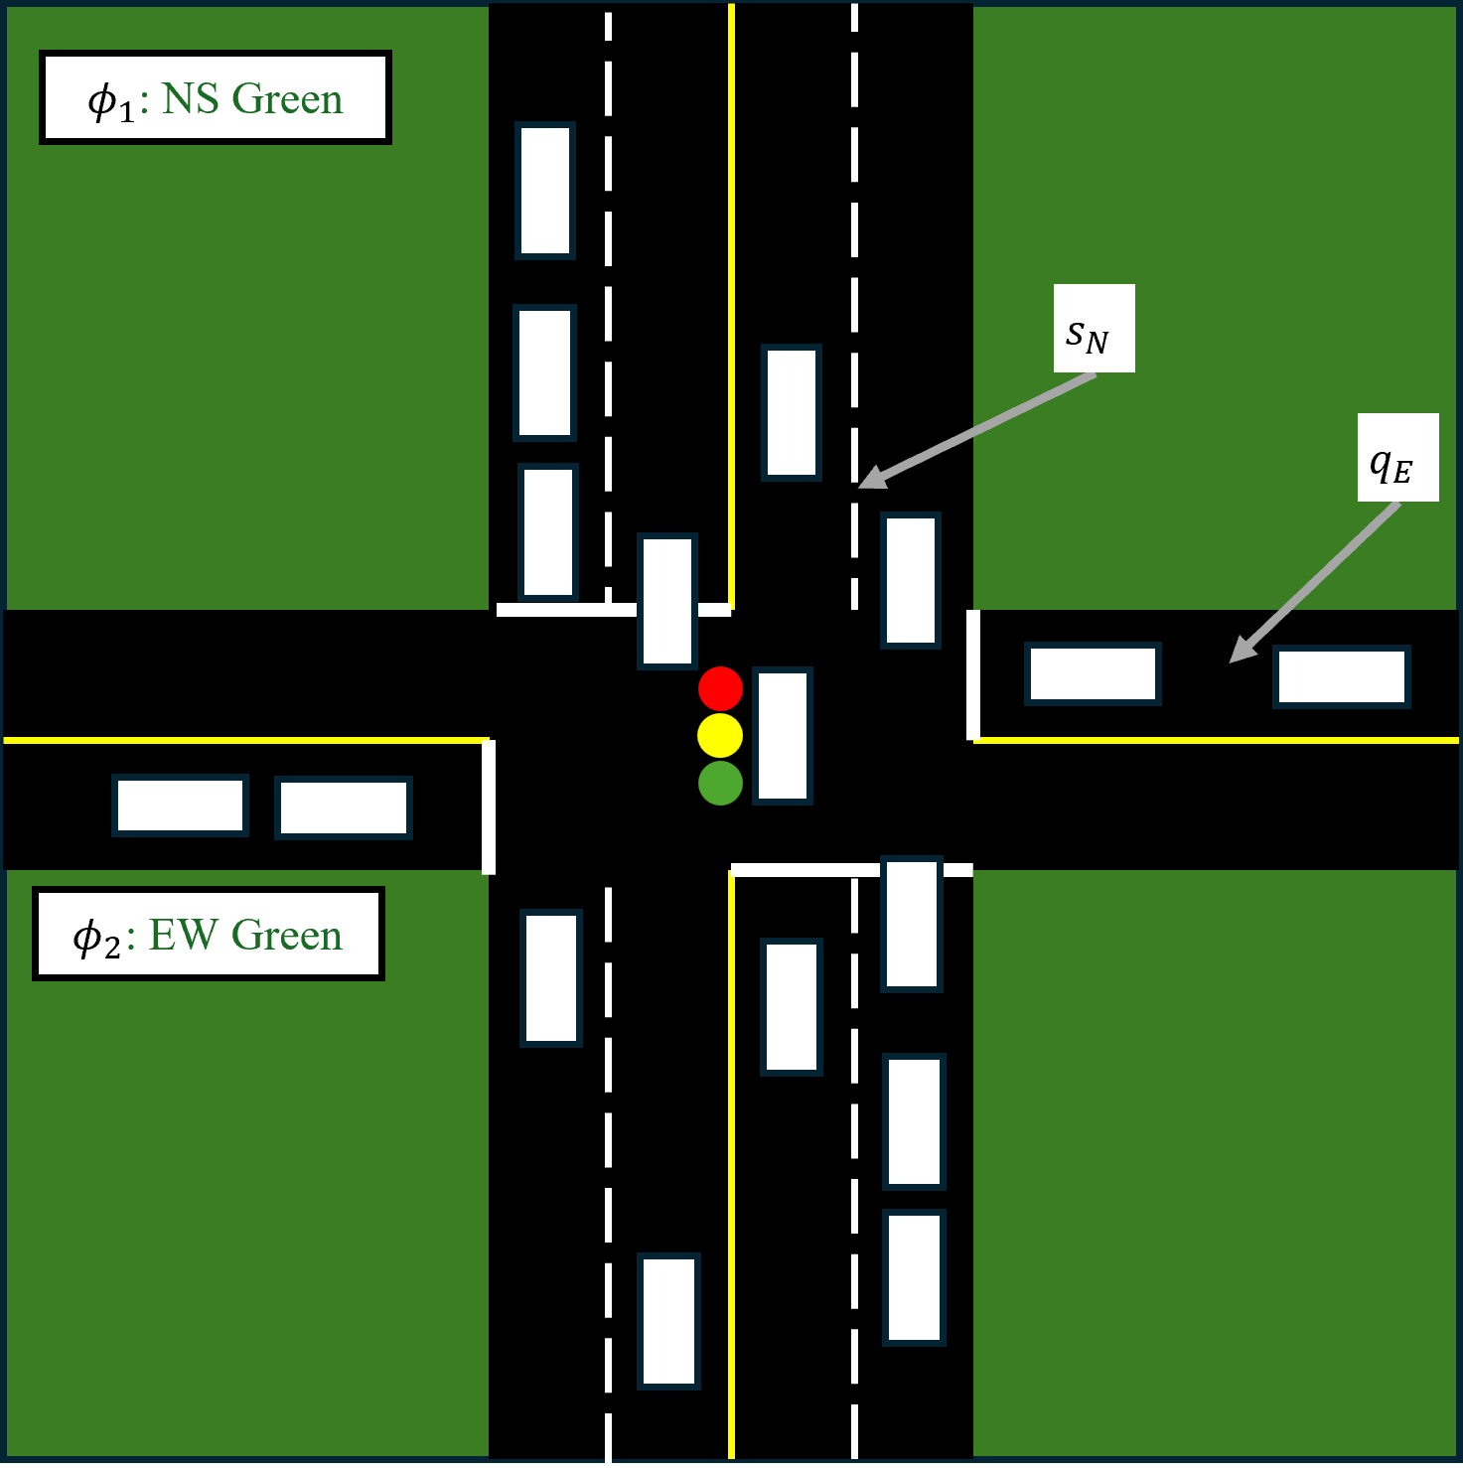
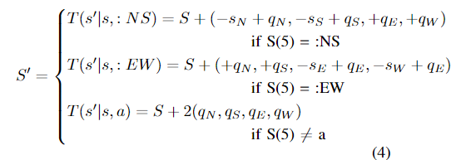
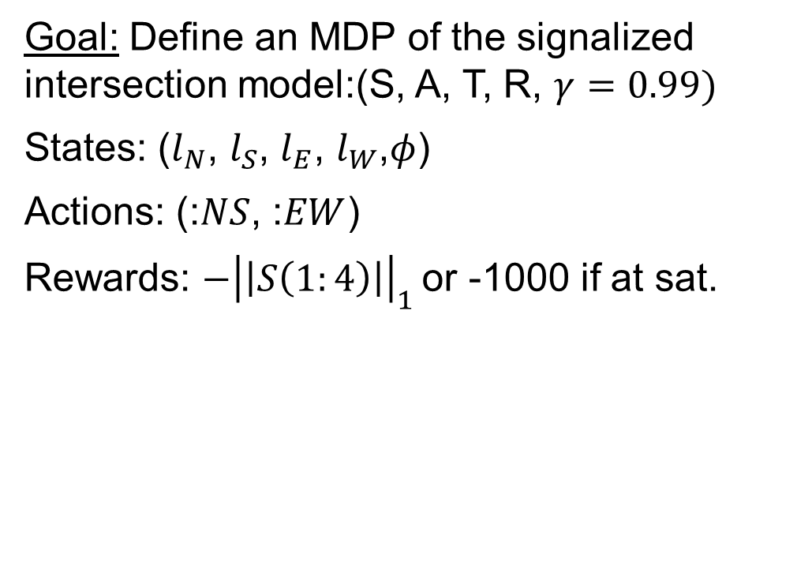
Background: Markov Decision Process Definition
Goal: Define an MDP of the signalized intersection model:(S, A, T, R, $γ=0.99)$
States: ($l_{N}$, $l_{S}$, $l_{E}$, $l_{W}$,$φ$)
Actions: (:$NS$, :$EW$)
Rewards: $−{\left|\left|S\left(1:4\right)\right|\right|}_{1}$or -1000 if at sat.
Notes:
Now let’s take a model intersection and frame it as an MDP
Intersection have 2 lanes going NS and one EW
The states are the queue lengths at each approach
The actions are the phases, either Green NS or Green EW
The reward is the negative total sum of the queue lengths
And the transition function lets cars through when the light is green. Note that if the light switches, there’s a 2-sec all-red penalty.
ASSUMPTIONS:
No turns or complex movements
Deterministic $s_{i}$. Stochastic $q_{i}$ that samples from a Poisson distribution.

Slide 6
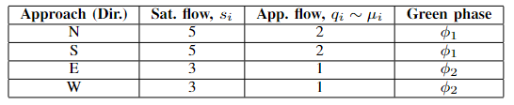
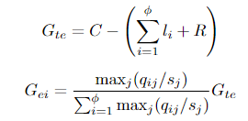
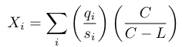
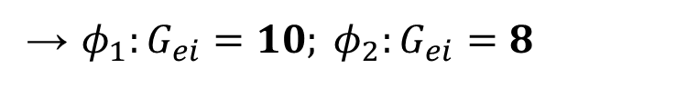
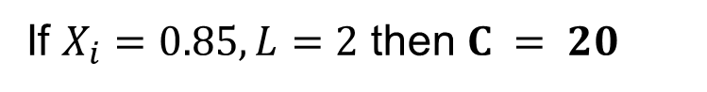
Methods: Critical Movement and Capacity Analysis
Apply capacity analysis to MDP [7]:
Step 1, 2: Identify phases and flow-rates*
Step 4: Allocate green times
Step 3: Identify total cycle length
→ $φ_{1}:G_{ei}=10; φ_{2}:G_{ei}=8$
If $X_{i}=0.85, L=2$ then $C = 20$
*How are these estimated?
Saturation flow is usually a function of geometry
Approach flow must be estimated from forecast data or on-the-ground measurements
Notes:
Let’s apply this. I have the flows the above values and prescribed the phases.
Using the formulas, the NS should get 10 sec, EW should get 8, and 2 sec is the all-red
Spend a moment on how we estimated these!

Slide 7
Methods: Critical Movement and Capacity Analysis
Apply capacity analysis to MDP [7]:
Step 1, 2: Identify phases and flow-rates*
Step 4: Allocate green times
Step 3: Identify total cycle length
→ $φ_{1}:G_{ei}=10; φ_{2}:G_{ei}=8$
If $X_{i}=0.85, L=2$ then $C = 20$
*How are these estimated?
Saturation flow is usually a function of geometry
Approach flow must be estimated from forecast data or on-the-ground measurements
Notes:
Saturation flow is a fcn of geometry – well known
But the approach flow must be estimated – either from forecasting or measurements.
So this variable is typically uncertain! And can change throughout the day.
In fact, most intersections perform this analysis and have dozens of cycles that change with time of day, day of week, and month to month!

Slide 8
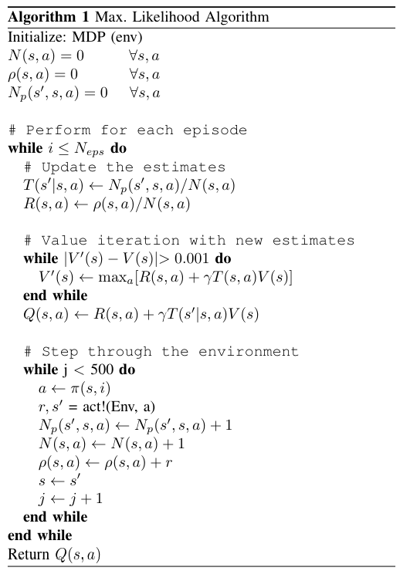
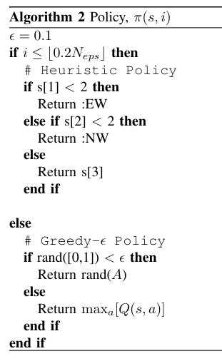
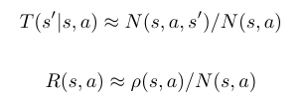
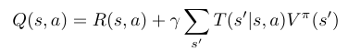
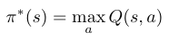
Methods: Maximum Likelihood
Goal: Use a model-based RL method to estimate transition and rewards to build an exploitative policy.
Notes:
Now outline the RL mode
We want a RL that can overcome this limitation by learning the traffic model
Thus, use model-based max likelihood – ultimately build estimate of Q(s,a) for optimal policy under deployment

Slide 9
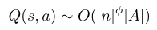
Methods: Notes on Implementation
Problem: State-space will explode under current construction!
Under 4 approaches and a 50-vehicle limited queue: Q(s, a) ~ 12.5M values!
Resolution: Model reduction via grouping NS and EW lanes as a lumped queue length. With 50-veh limited queues: Q(s, a) ~ 5,000 values.
→Faster to train and easier to reason over!
Notes:
Now to implement. First we must cap the number of cars in a queue to discretize the space.
If we keep the 4-lane mode with a 50-lim cap, Q(s,a) becomes a 12.5M value dict!
Too much to train and reason over
Reduce to NS and EW groupings by phase instead – now only 5000!

Slide 10
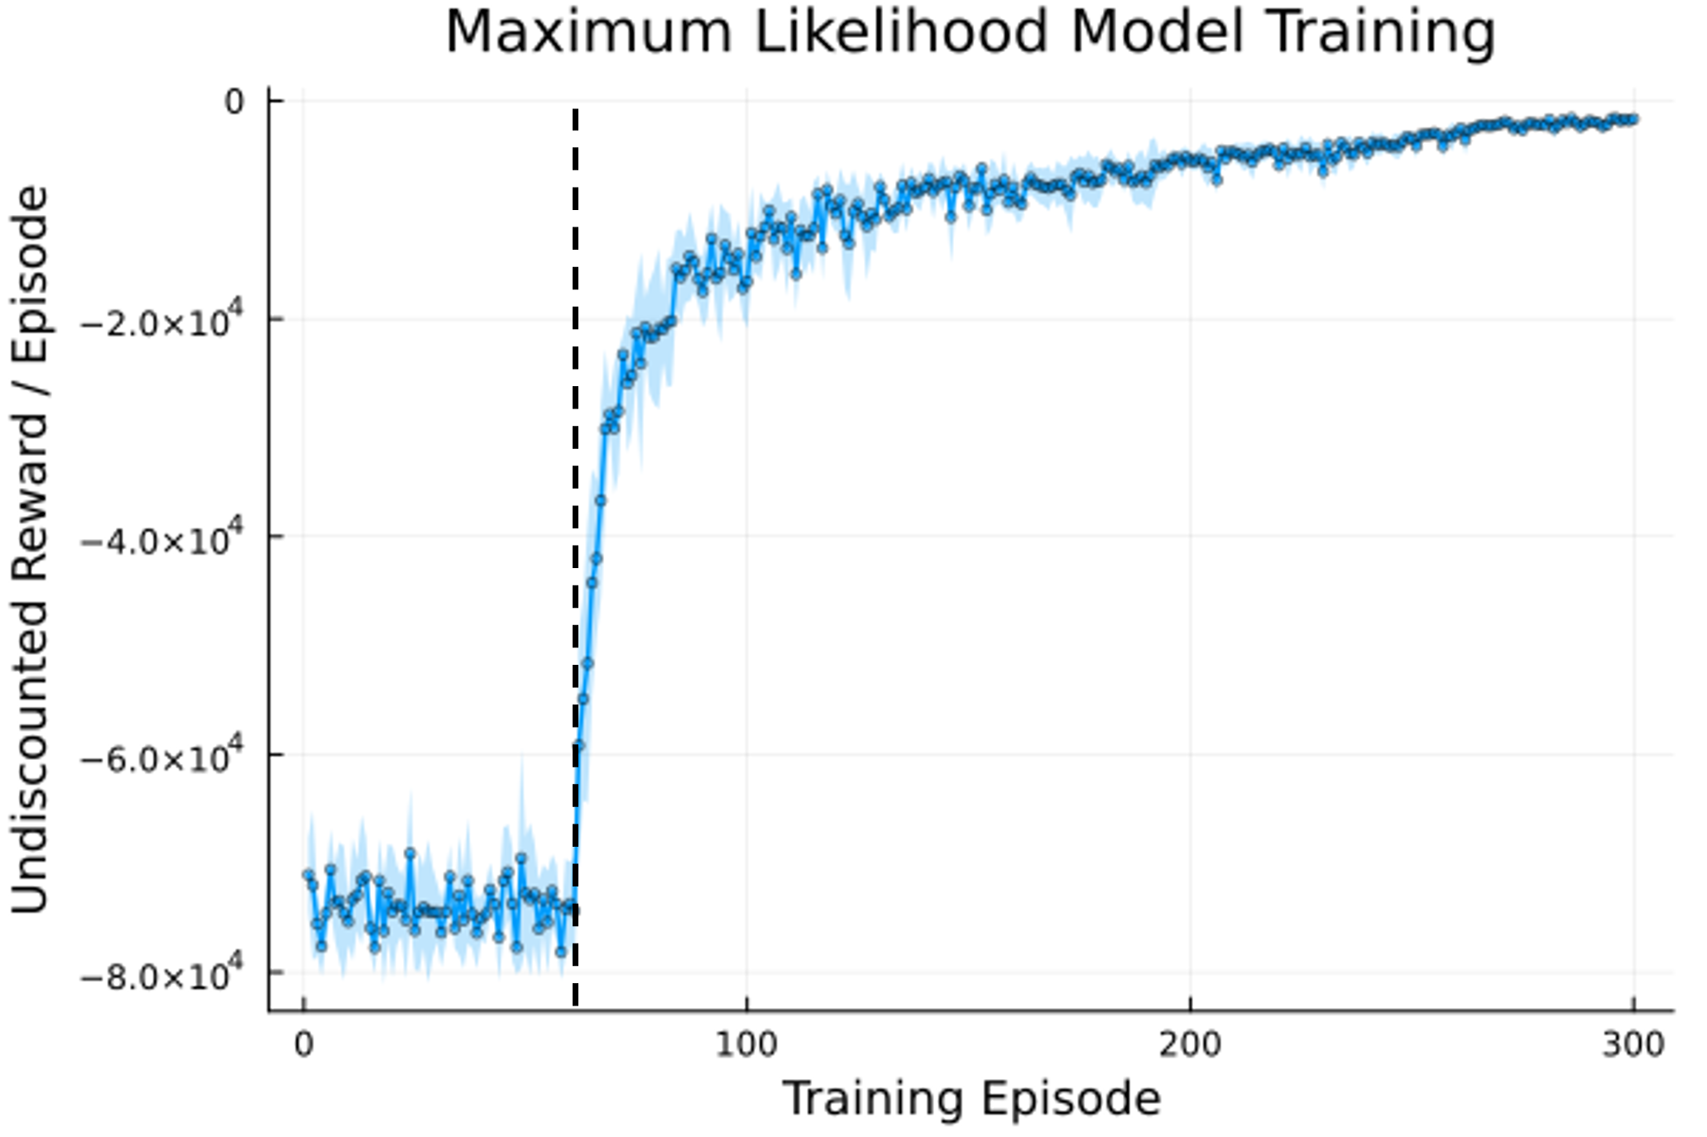
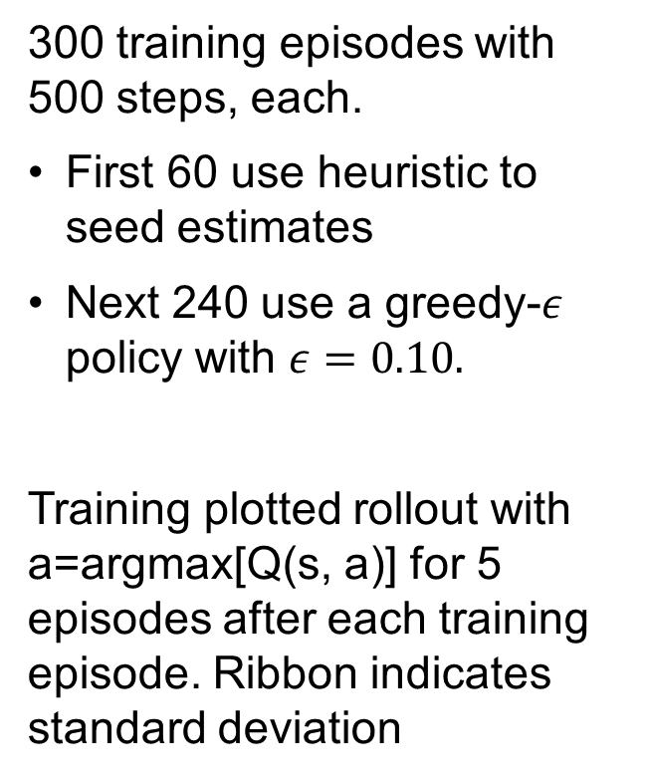
Results: Training
300 training episodes with 500 steps, each.
First 60 use heuristic to seed estimates
Next 240 use a greedy-$ε$ policy with $ε=0.10.$
Training plotted rollout with a=argmax[Q(s, a)] for 5 episodes after each training episode. Ribbon indicates standard deviation
Notes:
300 training episodes, 500 simulated steps each
First 60 use a heuristic
Next 240 use a greedy-eps policy
Then we use the optimal policy and run a simulated rollout 5x at each training point to produce the curve
Heuristic seeds, greedy-eps optimizes! Training is stable and generally sample efficient

Slide 11
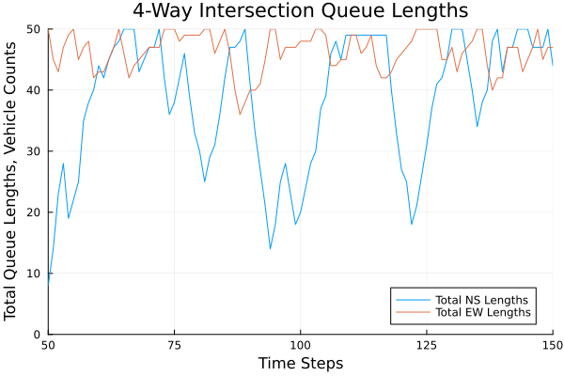
Results: Training (25%)
Notes:
Let’s look more closely at the simulated rollouts. Here’s a plot of a = argmax(Q(s,a)) during the training period. Clearly failing

Slide 12
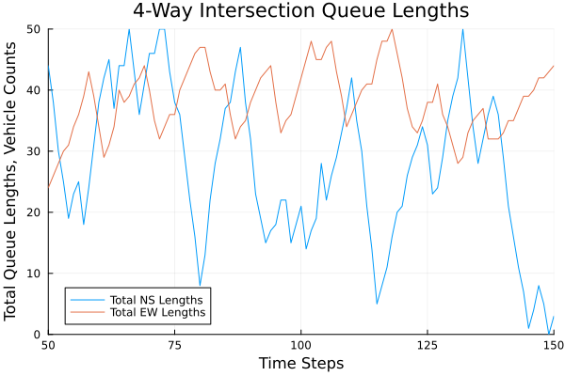
Results: Training (50%)
Notes:
50% - now it’s minimizing the peaks and avoiding saturation

Slide 13
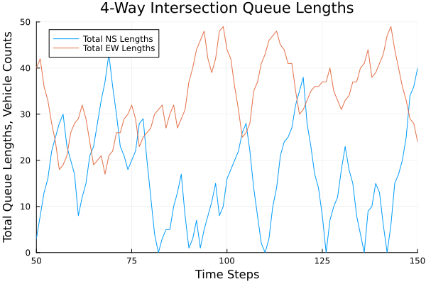
Results: Training (75%)
Notes:
75% is driving it close to zero

Slide 14
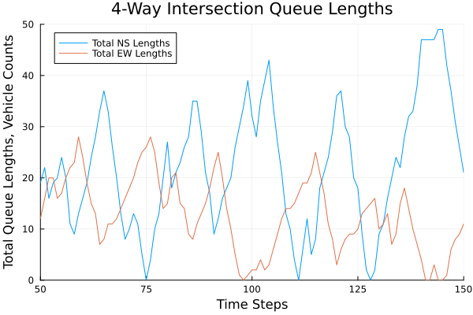
Results: Training (90%)
Notes:
90% sees stable peaks that are close to zero in both EW and NS phases

Slide 15
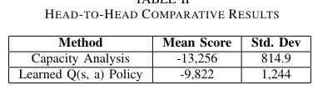
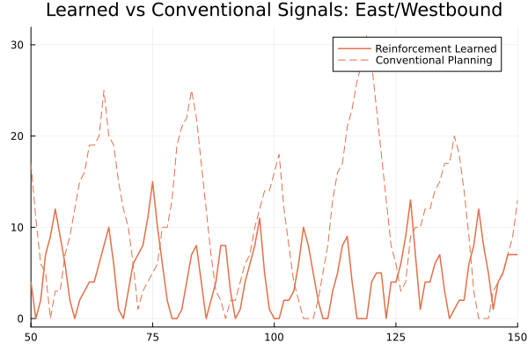
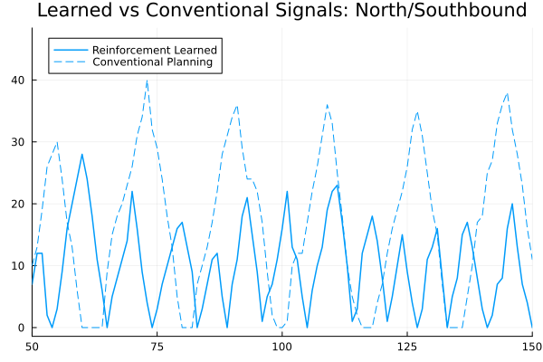
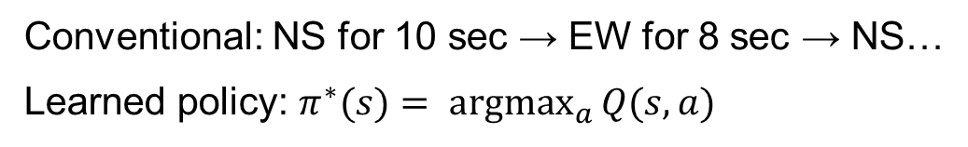
Results: Head-to-Head Comparison
Conventional: NS for 10 sec → EW for 8 sec → NS…
Learned policy: $π^{∗}(s)= \underset{a}{argmax}{Q(s, a)}$
Notes:
At 100% we compared it head-to-head. L is EW learned vs conventional. R is NS.
Reinforcement is doing a much better job of keeping the lengths down by effectively switching the light faster
Simulated 50 rollouts and the learned undiscounted reward was about 25% better than the conventional
Primary reason is that the RL system learned to reason over the states, while the conventional cannot see the states

Slide 16
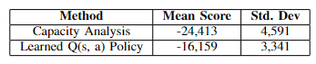
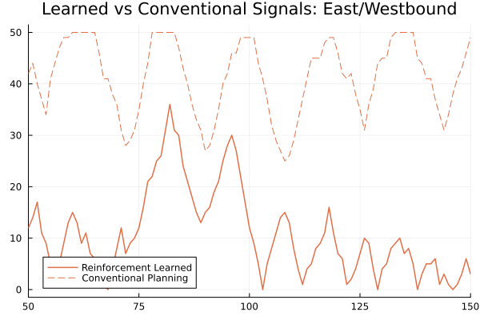
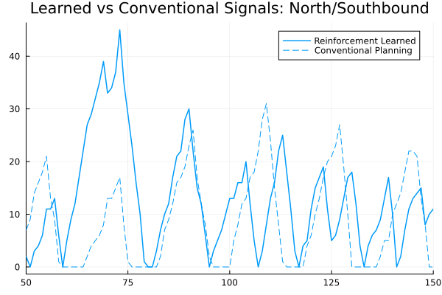
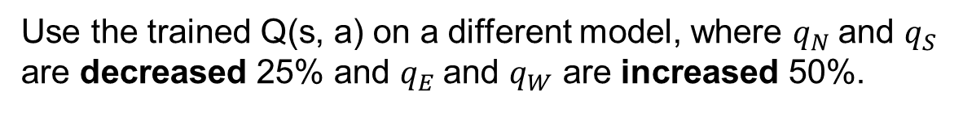
Results: Robustness
Use the trained Q(s, a) on a different model, where $q_{N}$and $q_{S}$ are decreased 25% and $q_{E}$and $q_{W}$ are increased 50%.
Notes:
Let’s expand this idea by looking at how robust this is.
Using the same controllers we now perturb the traffic model by increasing the EW flows by 50% and decreasing the NS by 25% (to ensure a stable intersection)
Conventional analysis fails in EW while the RL controller kept the queues low
NS performed similarly
Numerical improvement too

Slide 17
Conclusions and Future Work
Conclusions:
Signalized traffic system can be represented using an MDP formulation
A maximum likelihood RL to solve the MDP.
A learned model outperforms the state-of-the-art on a trained system and on a perturbed system.
Future Work:
POMDPs: exact queue lengths are required to solve the MDP, which may not be fully known. A POMDP formulation may better represent a physical system
Continuous state-space: this formulation is sensitive to state explosion under complex phasing. A continuous state-space may handle this better.
Notes:
Read out

Slide 18
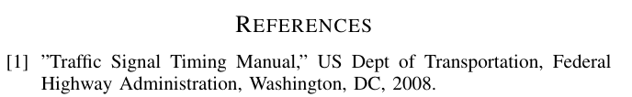
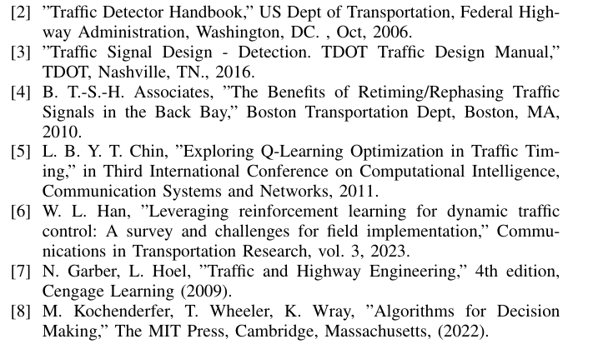
Citations

Slide 19
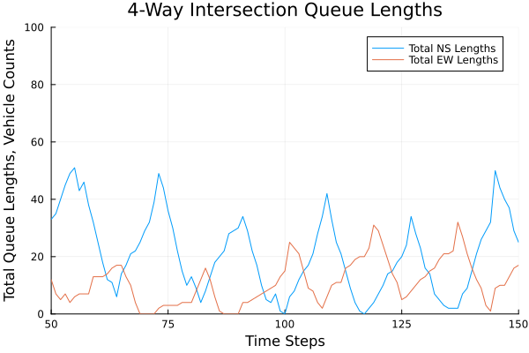
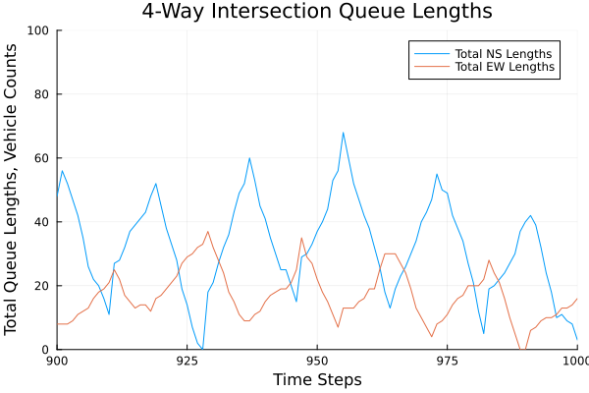
Appendix: Nominal Performance
Capacity and critical movement timing as applied to the model. Queue lengths are stable with time.

Slide 20
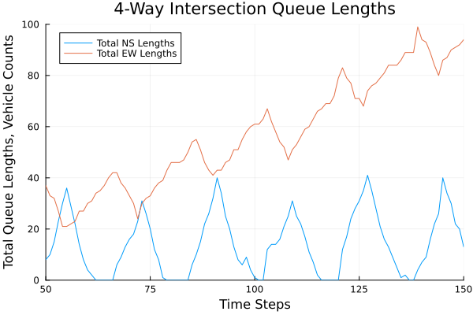
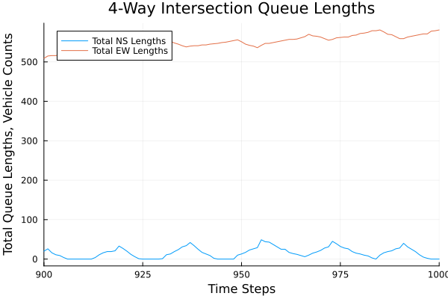
Appendix: Perturbed Performance 1
Capacity and critical movement timing as applied to the model, but the NS phase is given an additional 2 time-intervals and EW is reduced by 2.

Slide 21
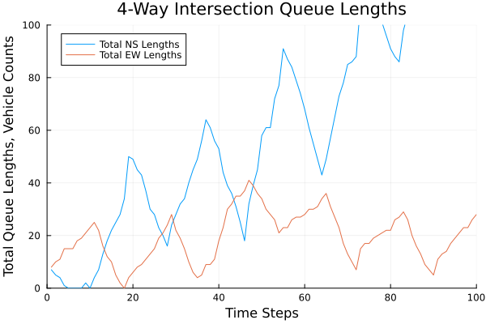
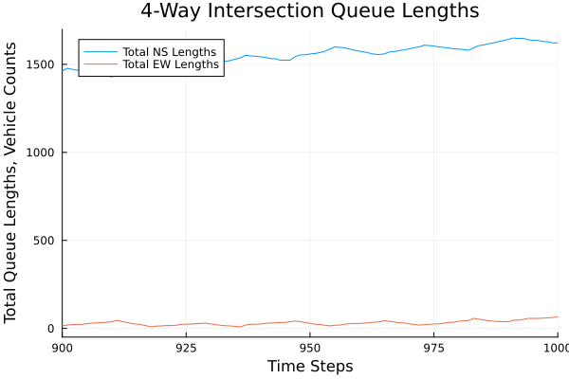
Appendix: Perturbed Performance 2
Capacity and critical movement timing as applied to the model, but the NS incoming flow is increased by 50%.

